Slide 1


Test First - TDD & BDD, What Everyone Should Know
by Shane Hayes,
Octopus Software LLC,
Arlington, TX

Slide 2
Agenda
Importance
Managers
Team members
Approach (15 min)
What is TDD/BDD?
Who does what when?
A coding example (45 min)
Questions/Discussion (30 min)

Slide 3
Importance for Leaders
As a coach and leader, how can you help them if you don’t understand the impact of the:
Approach?
Impact on daily work?
Especially the implication on the ingrained habits the team members currently have
Collaboration and work allocation
Inputs and outputs
Impact on processes and tooling?
Training and support needed?
Costs and benefits?

Slide 4
Importance to Team Members
How can your team compete in a competitive world economy?
Get on par with “internet native” teams (think Google)
Speed up by:
Improving key collaboration and clarity on real goals
Moving tests earlier in the development lifecycle
Finding testable designs faster and reduce re-design to allow for testing
Preserving business rules in technical and business friendly way
Improve quality by:
Have much faster quality feedback loops
Tighter quality integration with development
We never lose our “why” the work was done

Slide 5
TDD And BDD, What Are They?
BDD – Behavior Driven Development
Collaborating on business specifications with examples to improve communication about story intent, preserve that information and make it quickly “proveable”
AKA ATDD, Specification by Example
TDD – Test Driven Development
Quick short cycles of design specifications (including detailed examples), creating designs and quickly validating those designs

Slide 6



BDD Flow
Epic 1
Story 1
Story 2
Story 3
Outcome
Story 1
Example 1
Given
When
Then
Customer &
Business
Values
Goal
Theories -Backlog
Lite Design 1
Class 1
Method 1
Method 2
Class 2
Specification Tests
Spec. Edge Tests
Unit/ Design Tests
Deliverables:
Great team collaboration
“Living” spec document
Incremental, provable progress
Balance between spec and unit testing
Discipline on testing and sequence
Applications designed to be auto tested
Missing: value feedback
Application Code
Red (fail)
Right a test that fails
Refactor
Repeat
Green (pass)
Improve design & code
Just enough code to pass
Notes:
BDD itself does not call out measuring actual value delivered as in a Minimally Viable, Valuable and Validated Product. That can be done by putting in value measurements and usage instrumentation like what is suggested in Lean Startup.

Slide 7
TDD
There is a simple, very short cycle to this:
Write a test for a design
See it fail
Write code to get it to pass
Clean and improve as you go
Red (fail)
Right a test that fails
What impact do you think it has on the code that is written?
Smaller, more focused:
Methods
Classes
Less coupling, fewer dependencies
Repeat
Refactor
Green (pass)
Improve design & code
Just enough code to pass

Slide 8

Who “Does” BDD/TDD?
The “Three Amigos” – PO/BA, Dev and Tester – “everyone”
It starts with the Product Owner who is the subject matter “expert” on what the value is of the Epic/Story
As much as they can, the PO puts pen to paper to describe the value & what they want to get out of the epic/story
Accountable and responsible to the stakeholders to get the value (Key part of job – “cat herder” for stakeholders)
Accountable and responsible to provide clarity to the development team (Key part of job – “speak with one voice” on behalf of stakeholders)
An “Analyst” or other SME can assist the PO in getting clarity on the details – business rule examples
Notes:
Why do I like dev and tester? Two primary reasons:
Having a least two people to perform and important function increases the chance of rule compliance. An example is money handling, almost always done with two people so that they would need to take the risk of collusion to be non-compliant (theft).
Building and testing of have different mindsets, like matching and mis-matching personalities. Both are valuable to the team. Should everyone be able to do both – absolutely, but lets take advantage of people’s strengths and tendancies.

Slide 9
When “Does” BDD/TDD Start?
In Release Planning, the PO will describe the Epics/Story shells to collaborate with team on initial high-level sizing:
Team will take the info from the PO and details just enough to size
Any details and assumptions will be captured:
In order to [get this customer/business value]
As a [role]
I want [this feature or functionality]
And might have acceptance criteria, but usually come later (examples):
Given [a repeatable starting point]
When [system or user action]
Then [a predictable and measurable result]
The PO will add whatever detail they can to maximize the clarity of the story prior to the start of the sprint (continued refinement)
Note - no test automation yet – just collaboration, learning and some “documentation”

Slide 10
Who “Does” BDD/TDD (2)?
In Backlog Refinement:
The PO/BA or other SME will work to define each story to bring in “well baked” stories. Imagine the cost per hour of having the entire squad “write” the story if they don’t
The meeting continues the ongoing collaboration with the team. The focus should be on Acceptance Criteria and design assumptions to make the desired outcome clear (not just the “how”).
The collaboration is additive such as adding UI layouts, UX process designs, other just-in-time research and standards like API
Any new stories added to the backlog during this meeting ideally would have just enough information to size the story

Slide 11

Who “Does” BDD/TDD (3)?
In Sprint Planning, the 3 Amigos will determine:
Decide if we really have a story that is ready according to our Definition of Ready (DOR)
Review details on story, clarify any uncertainty and plan approach to remove uncertainty if some still exists
Decide on approach to specification/unit testing (test plan) in addition to our normal development activities
In Story Execution:
PO/QA/Dev will update the application’s “as-built” specification file- the “.feature” file
Dev/QA will update the step-def file to draft a failing step definition “gluing” the spec to the application
Developer will then start the Red/Green/Refactor process of TDD:
TDD: Write unit test and see it fail
TDD: Write just enough code to get the unit test to pass
BDD: Refactor the step definition to execute application to fail/pass
TDD/BDD: Continue writing tests and code until the step definitions pass
BDD: Start process over on next acceptance criteria
Definition of Done (DOD) will be to measure a complete story
Red (fail)
Right a test that fails
Repeat
Refactor
Green (pass)
Improve design & code
Just enough code to pass

Slide 12
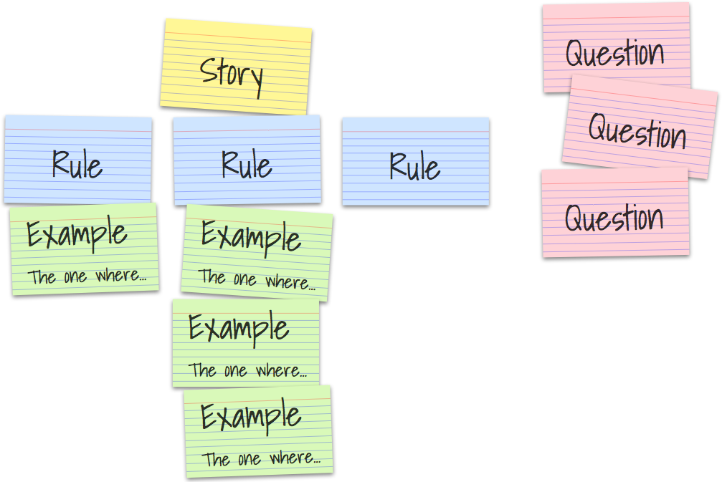
Where Does AC Come From?
From Matt Wynne
Notes:
Here is a picture from Matt Wynne’s nice blog on example mapping https://cucumber.io/blog/example-mapping-introduction/

Slide 13


Benefits
Speed up delivery
Increase quality
Improve designs
Deliver accurate, durable “as built” specifications – “stories” do not
Easily pass any traceability requirements
Keep specifications in sync with the reality of the application
Assist with automated testing to keep application durable

Slide 14
Enough Theory – Now an Example
Lets use a Roman Numeral conversion:
Start with an epic & refinement to get good stories
Create a project
Create a feature, scenario, and an acceptance test
Generate a step definition (glue code)
Run the step (functional test) and see it fail
Create a unit test to drive the code development
See the unit test fail
Write application code until the unit test passes
Continue writing application code until feature passes
Continue writing tests then code until all unit and acceptance/specification tests pass
Notes:
As managers, leaders and performers, we all need to understand this in order to make it happen. If the leadership does not understand it well enough, they are likely to miss the value so will discourage their people from learning about it and attempting it.

Slide 15
Feature/ Requirement
Feature: In order to reduce confusion with Roman Numerals
As a reader of roman numerals in a movie studio
I want to translate the numbers to Arabic numbers
Scenario: translate simple numbers
Given a simple Roman Numeral
When I ask for a translation
Then I get the correct Arabic number
Scenario: translate combinations of numbers
Given a Roman Number combination of characters
When I ask for a translation
Then I get the correct translation for combination of Roman numerals in Arabic numbers
What are the details? How do we know if we got this right? Who is an expert on Roman Numbers?
How about an example?

Slide 16
Details on Feature
Scenario: translate simple Roman Numerals to Arabic
Given a single digit Roman Numeral
When I ask for a translation
Then I get the correct Arabic Number:
| Roman Numeral | Arabic Number |
| I | 1 |
| V | 5 |
| X | 10 |
| L | 50 |
| C | 100 |
| D | 500 |
| M | 1,000 |
| B | Invalid Digit |
| # | Invalid Digit |
| 2 | Invalid Digit |
You may know how to translate some Roman Numerals, but imagine how much faster development and estimating will be if you are delivered specification examples? How about geographically separated team mates?
Notes:
A good reason why a description of BDD might be specification by example.

Slide 17
Four Stories in Roman Epic
Why four?
Incremental, real progress
Incremental learning
Smaller stories can be spread across multiple developers
Smaller stories are usually faster – more focus
Story 1
Single digit Roman to Arabic
Story 3
Arabic to Roman Conversion
Story 2
Multiple digit Roman to Arabic
Story 4
Error handling

Slide 18
Open Up Project
We will:
Create a new project with no application code, a maven pom file pointing to the Cucumber and jUnit libraries: RomanConversionStarting
Create a feature file that outlines the business value/intent of what we want to build
Start with an Epic – Support Roman Numeral conversion
Start with one story:
Convert from Roman Numerals to Arabic

Slide 19
Let’s Get Coding – Refactoring Specs
Let’s start by refactoring the specs, separating out the error handling into a separate scenario in the RomanNumerals.feature file:
Feature: In order to reduce confusion with Roman Numerals
As A reader of roman numerals
I want to translate the numbers to Arabic numbers
Scenario Outline: translate simple numbers to Arabic
When I ask for a translation of a "<Roman Numeral>" Then I get the correct "<Arabic Number>" Examples: | Roman Numeral | Arabic Number | | I | 1 | | V | 5 | | X | 10 | | L | 50 | | C | 100 | | D | 500 | | M | 1,000|
Scenario Outline: translation error numbers When I ask for a translation of a "<Roman Numeral>" Then I get the invalid numeral error Examples: | Roman Numeral |
| B |
| # |
| 2 |
Notes:
This shows that we may need to tweak the specs as the come from stories

Slide 20
Lets Get Coding – Refactoring Specs
Now lets re-run the tests to see the test count (we are starting our development with failing tests!
We now have 10 scenarios and 20 steps (driven by the Examples)
We can now start making these business specifications “executable” by creating code to glue the specs to the application (which does not exist yet)

Slide 21
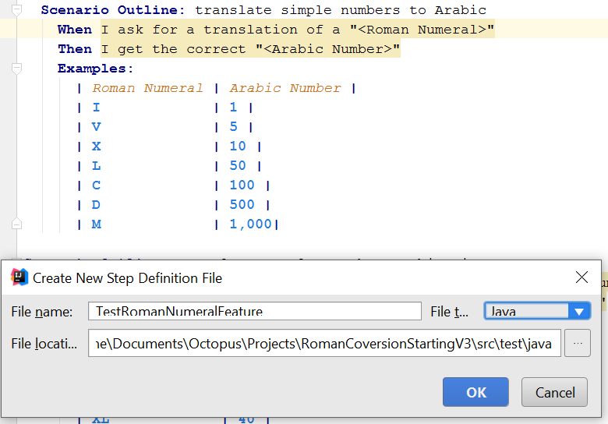
IDE Code Generation
Select the AC to start coding for
Request the step code to be generated from the IDE
public class TestRomanNumeralFeature { @When("^I ask for a translation of a \"([^\"]*)\"$") public void iAskForATranslationOfA(String arg0) throws Throwable { // Write code here that turns the phrase above into concrete actions throw new PendingException(); } @Then("^I get the correct \"([^\"]*)\"$") public void iGetTheCorrect(String arg0) throws Throwable { // Write code here that turns the phrase above into concrete actions throw new PendingException(); } }

Slide 22
Using Examples in Spec
Examples make involved specifications easier to understand, but then requires some special coding with the glue code:
Add a “helper class” to bridge between the When and Then parts
Code in step definitions that makes use of the handler class and references a new class that is not defined yet: RomanNumbers
public class ConversionEntry { String romanNumeral; Integer arabicNumber; public void setRomanNumeral(String romanNumeral) { this.romanNumeral = romanNumeral; } public void setArabicNumber(int anArabicNumber) { this.arabicNumber = anArabicNumber; } public String getRomanNumeral() { return romanNumeral; } public int getArabicNumber() { return arabicNumber; } }
private ConversionEntry aRomanConversion; @When("^I ask for a translation of a \"([^\"]*)\"$") public void iAskForATranslationOfA(String romanNumeral) throws Throwable { aRomanConversion = new ConversionEntry(); aRomanConversion.romanNumeral = romanNumeral; //no test done, this is setup for the next step } @Then("^I get the correct \"([^\"]*)\"$") public void iGetTheCorrect(String anArabicNumber) throws Throwable { assertEquals(anArabicNumber, RomanNumbers.toArabic(aRomanConversion.romanNumeral)); }

Slide 23
Where Are We Now?
We have a fully code test that makes our spec “executable”
Now we need application code
We start the TDD process of writing code:
Write a test to describe our design, see it fail
Invent code to get the test to pass
Refactor to ensure we have an implementation that not only works, but is “right”

Slide 24
Let’s Get Coding - TDD
Now we can write some application code
Start simple, translate some single digit value
Design question? Where do we store the knowledge of the conversion from Roman to Arabic?
Lets convert a couple of simple values
public class TestRomanNumeralUnitTests { @Test public void testSimpleArabicToRoman () { assertEquals(1, RomanNumbers.toArabic("I"),"1 should be the outcome"); assertEquals(5, RomanNumbers.toArabic("V"),"5 should be the outcome"); } }
So we now have some failing tests, mainly compilation errors on the RomanNumbers class and methods

Slide 25
Now For Application Coding
Create RomanNumbers class and write a method
And an enum class RomanNumeral
public class RomanNumbers { public static int toArabic(String aRomanNumber) throws IllegalArgumentException{ RomanNumeral aRomanNumeral = RomanNumeral.valueOf(aRomanNumber); switch (aRomanNumeral) { case I: return RomanNumeral.I.getArabic(); case V: return RomanNumeral.V.getArabic(); default: throw new IllegalArgumentException("Invalid Digit " + aRomanNumber); } } }
public enum RomanNumeral { V(5, "V"), I(1, "I"); private final int arabic; private final String name; private RomanNumeral(int arabic, String name) { this.arabic = arabic; this.name = name; } public int getArabic() { return arabic; } public String getName() { return name; } }
Notes:
The first class is the conversion, basically a lookup. A lookup in another class, an emum.

Slide 26
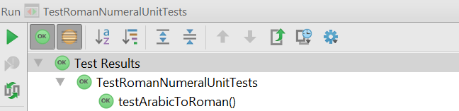
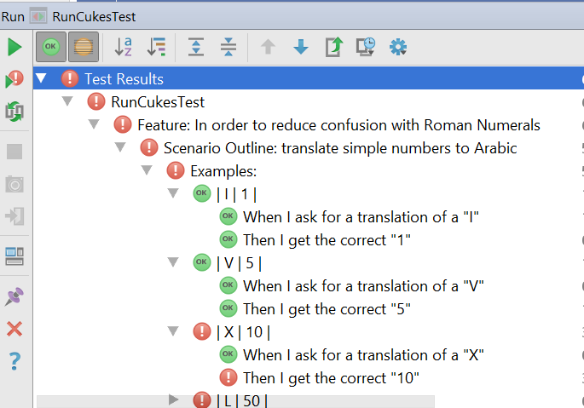
Green Results
Our unit tests went green.
Interesting, we ended up with more than 2 functional tests going green

Slide 27

Balance Unit & Functional Testing
Remember, a key part of our approach: collaboration!
The collaboration begins before the sprint, when the team is reviewing & sizing the story
In sprint planning, another round occurs, especially about testing – how far are we going with the various approaches – unit, functional and manual
While we develop the story, we have some collaboration on the testing details

Slide 28
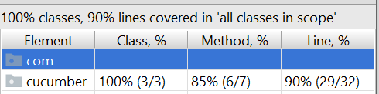
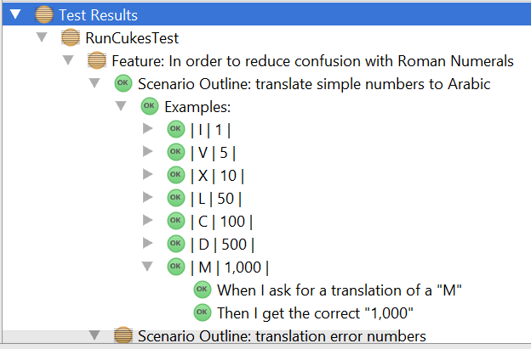
Our Testing Allocation Decision
We will use more of our functional testing than unit testing on the simple conversion
public enum RomanNumeral { M(1000, "M"), CM(900, "CM"), D(500,"D"), CD(400,"CD"), C(100, "C"), XC(90,"XC"), L(50,"L"), XL(40,"XL"), X(10,"X"), IX(9,"IX"), V(5,"V"), IV(4,"IV"), I(1,"I");
public class RomanNumbers { public static int toArabic(String aRomanNumber) throws IllegalArgumentException{ RomanNumeral aRomanNumeral = RomanNumeral.valueOf(aRomanNumber); switch (aRomanNumeral) { case I: return RomanNumeral.I.getArabic(); case V: return RomanNumeral.V.getArabic(); case X: return RomanNumeral.X.getArabic(); case C: return RomanNumeral.C.getArabic(); case D: return RomanNumeral.D.getArabic(); case M: return RomanNumeral.M.getArabic(); case L: return RomanNumeral.L.getArabic(); default: throw new IllegalArgumentException("Invalid Digit " + aRomanNumber);
Notes:
All of our functional tests pass. Are we missing anything? Not much, as the code coverage from our functional testing is at 90%

Slide 29
On To Complex Numbers
Generate more step glue code
Scenario Outline: translate common number combinations When I ask for a translation of a combination "<Complex Roman Numeral>" Then I get the correct combination translation "<Arabic Number>" Examples: | Complex Roman Numeral | Arabic Number | | IV | 4 | | IX | 9 | | XC | 90 | | XL | 40 | | CD | 400 | | CM | 900 | | MMXIII | 2013 | | MMMCMXCIX | 3999 |
@When("^I ask for a translation of a combination \"([^\"]*)\"$") public void iAskForATranslationOfACombination(String romanNumeral) throws Throwable { aComplexConversion = new ConversionEntry(); aComplexConversion.setRomanNumeral(romanNumeral); //no test done, this is setup for the next step } @Then("^I get the correct combination translation \"([^\"]*)\"$") public void iGetTheCorrectCombinationTranslation(Integer anArabicNumber) throws Throwable { assertEquals(Long.valueOf(anArabicNumber), Long.valueOf(RomanNumbers.toArabic(aComplexConversion.romanNumeral))); }
Notes:
We add some code and now the functional test is breaking instead of being undefined.

Slide 30
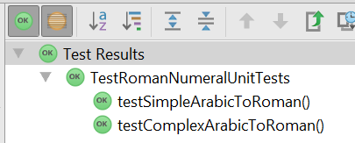
Code for Complex Numbers
Get unit test to fail
@Test public void testComplexArabicToRoman () { assertEquals(256, RomanNumbers.toArabic("CCLVI"), "256 should be the outcome"); }
Write and refactor code to get unit test to pass
public class RomanNumbers { public static int toArabic(String aRomanNumber) throws IllegalArgumentException{ RomanNumeral aRomanNumeral = RomanNumeral.valueOf(aRomanNumber); switch (aRomanNumeral) { case I: return RomanNumeral.I.getArabic(); case V: return RomanNumeral.V.getArabic(); case X: return RomanNumeral.X.getArabic();
public class RomanNumbers { public static long toArabic(String aRomanNumber)throws IllegalArgumentException { int arabic = 0; String romanName; for (RomanNumeral currentRomanNumber : RomanNumeral.values()) { //Iterate through all of the enums romanName = currentRomanNumber.getName(); while (aRomanNumber.startsWith(romanName)) { //We might have many instances of the same letter(s) arabic += currentRomanNumber.getArabic(); //based on finding a match, grab the associated value aRomanNumber = aRomanNumber.substring(romanName.length()); //remove the letter(s) we just found } } if (aRomanNumber.length() > 0) { throw new IllegalArgumentException("Invalid Digit " + aRomanNumber); //if we have anything left over, that is bad } return arabic; } }

Slide 31
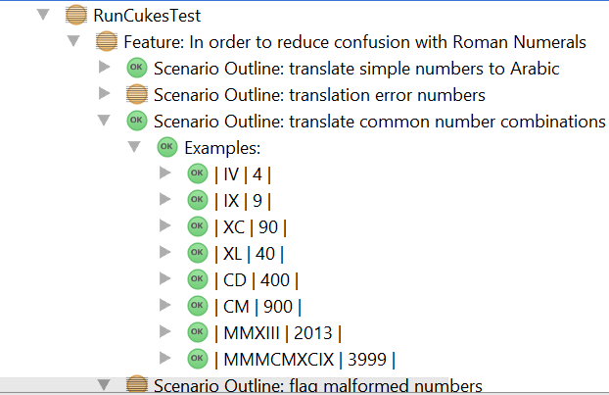
Get Functional Tests to Pass
Wow, all of the complex numbers passed and the single numbers continue to pass!

Slide 32
Three Kinds of Tests
Unit Testing
Functional Specification Testing
Some overlap is OK, we just need to be smart about it
Edge functional testing is important, but does not add to fast understanding of a specification
Examples of edge testing might be errors or boundaries
Edge Functional Testing
Story 1
Single digit Roman to Arabic
Story 2
Multiple digit Roman to Arabic
Living Documentation!

Slide 33
Refactoring Edge Specs
More refactoring the specs, separating out the error handling into a separate .feature file and improve names:
Scenario Outline: translation error numbers When I ask for a translation of a "<Roman Numeral>" Then I get the invalid numeral error Examples: | Roman Numeral |
| B |
| # |
| 2 |
Scenario Outline: flag malformed Arabic numbers When I ask for a Roman translation of a "<Bad Arabic Numeral>" Then I get the invalid arabic error Examples: | Bad Arabic Numeral | | 0 | | 4000 |
Scenario Outline: flag malformed numbers When I ask for a translation of a "<Bad Roman Numeral>" Then I get the an invalid numeral error Examples: | Bad Roman Numeral | | VC | | LD | | IIXV | | IC | | CM | | XD | | XM |
Notes:
This shows that we may need to tweak the specs as the come from stories

Slide 34
Add Roman Error Step/Glue Code
@When("^I ask for a translation of an invalid \"([^\"]*)\"$") public void iAskForATranslationOfAnInvalid(String romanNumeral) throws Throwable { anErrorConversion = new ConversionEntry(); anErrorConversion.setRomanNumeral(romanNumeral); //no test done, this is setup for the next step } @Then("^I get the invalid numeral error$") public void iGetTheInvalidNumeralError() throws Throwable { try { RomanNumbers.toArabic(anErrorConversion.romanNumeral); fail("Invalid RomanNumeral"); } catch (IllegalArgumentException e) { //do nothing here as the exception was expected } }
@Test public void testInvalidRomanNumeralB() { Throwable exception = expectThrows(IllegalArgumentException.class, () -> { RomanNumbers.toArabic("B"); }); assertEquals("Invalid Digit B", exception.getMessage()); } @Test public void testInvalidRomanNumeralComboVC() { Throwable exception = expectThrows(IllegalArgumentException.class, () -> { RomanNumbers.toArabic("VC"); }); assertEquals("Invalid Digit C", exception.getMessage()); }
Notes:
We will add both a glue code and a unit test code

Slide 35
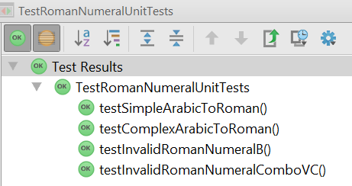
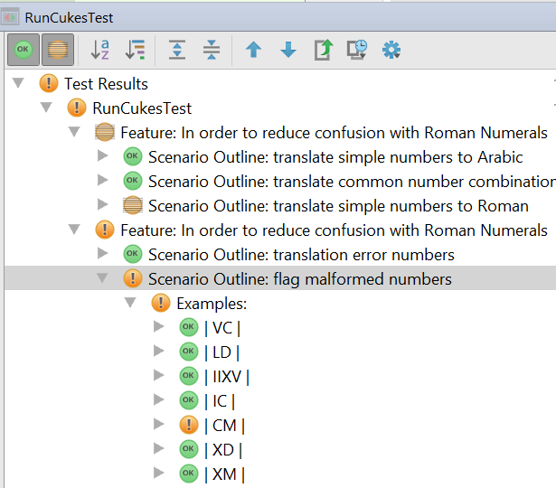
Edge Test Results
Our unit and most of the functional edge tests worked! All but one: CM!?
The spec is wrong and we need to correct it.
Notes:
Our unit tests worked to show our design to catch problems is working. Our edge functional tests found a problem! The actual problem was an error in specification – the requirement was wrong. We will eliminate that test as being invalid.

Slide 36
Story 4 Arabic to Roman Tests
Failing step code:
@When("^I ask for a Roman translation of a \"([^\"]*)\"$") public void iAskForARomanTranslationOfA(Integer anArabicNumber) throws Throwable { anArabicConversion = new ConversionEntry(); anArabicConversion.setArabicNumber(anArabicNumber); //no test done, this is setup for the next step } @Then("^I get the correct Roman Numeral \"([^\"]*)\"$") public void iGetTheCorrectRomanNumeral(String aRomanNumber) throws Throwable { assertEquals(aRomanNumber, RomanNumbers.toRoman(anArabicConversion.getArabicNumber())); }
Failing unit test code:
@Test public void testArabicToRoman () { assertEquals( "I", RomanNumbers.toRoman(1),"I should be the outcome"); assertEquals( "V", RomanNumbers.toRoman(5),"V should be the outcome"); }

Slide 37
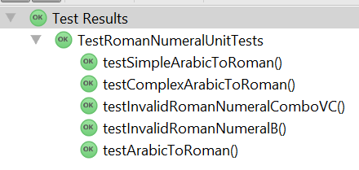
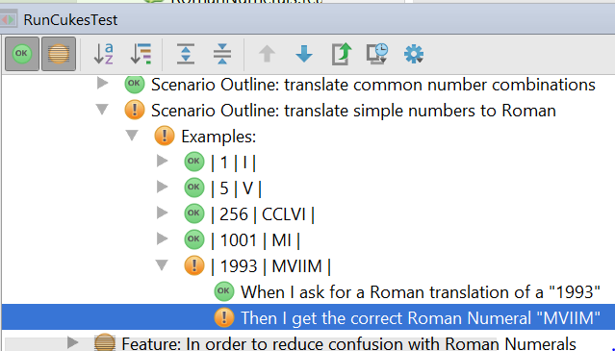
Arabic to Roman Code
public static String toRoman(int arabic) { StringBuilder result = new StringBuilder(); for (RomanNumeral numeral : RomanNumeral.values()) { //Iterate through all of the enums, large to small while (arabic >= numeral.getArabic()) { //starting with the larger values, subtract them out arabic -= numeral.getArabic(); //reduce number with matching number result.append(numeral.name()); //append found roman value } } return result.toString(); }
Another spec problem!
Notes:
Another failure – and again a specification problem

Slide 38
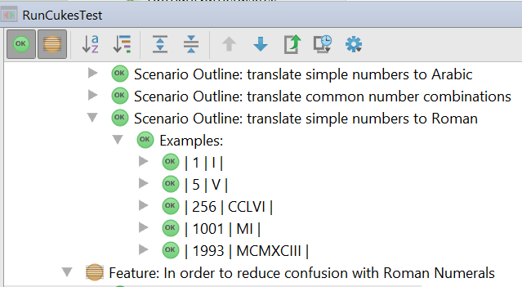
Fix the Specs
Scenario Outline: translate simple numbers to Roman When I ask for a Roman translation of a "<Arabic Number>" Then I get the correct Roman Numeral "<Roman Numeral>" Examples: | Arabic Number | Roman Numeral | | 1 | I | | 5 | V | | 256 | CCLVI | | 1001 | MI | | 1993 | MCMXCIII |
Notes:
Tests now pass! We have completed the main part of the story, only have some error handling left

Slide 39
Lets Jump To The End
Add last error handling:
Step code
Unit test code
Application code

Slide 40
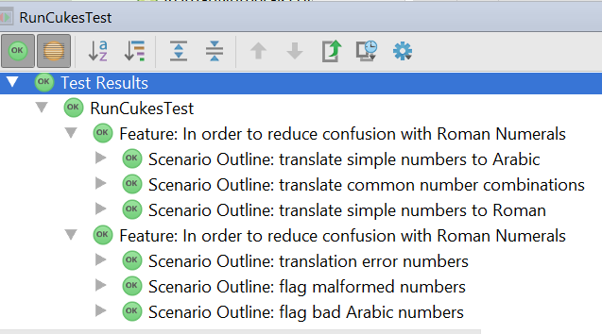
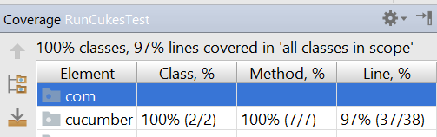
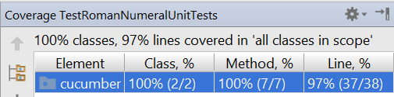
Everything Works Now!
Notes:
Everything works with 97% code coverage from the functional tests.

Slide 41
So What Do We Have?
Great and early collaboration on Quality
“Living Documentation” that the business can understand and is “proveable”
Very easy traceability – an “as built” spec
“Stories” do not deliver an as build spec
Imagine your last project was done this way
A fast path to applications that are designed to be testable with automation
Both unit and functional tests with a practical balance between the two
Tests linked, stored and protected with the source code

Slide 42

Questions?

Slide 43
